Slide 1

以人臉五官預測性取向
Member：
機械所碩一 吳政霖
機械所碩一 卓靖鎧
工科所碩二 呂姿霖
Professer：謝舒凱 教授

Slide 2

Outline
Introduction
Data Preprocessing
Modeling
Application
Conclusion
Q&A and Discussion

Slide 3

Introduction

Slide 4

Project Introduction
Purpose：
To determine if sexual orientation can be correctly identified through face features
Image Source：
Public dating and relationship website
Public Figure
Team members’ friends
Date Size：
Training：200 images for like guys, 200 images for like girls
Testing：9 images from members

Slide 5
Related Work
Research Organization：
Stanford University
Research Name：
Deep Neural Networks Are More Accurate Than Humans at Detecting Sexual Orientation From Facial Images
(Journal of Personality and Social Psychology, 2018)
Results：
Distinguish between gay and heterosexual men in 81% of cases, and in 71% of cases for women. (from 35,326 training images, myPersonality.org)

Slide 6
Project Flow
Data Collection
Data
Preprocessing
Model Building
Model Training
All
政霖
Model Evaluation
Results Analysis
Web
Application
姿霖
靖鎧

Slide 7

Data Preprocessing

Slide 8
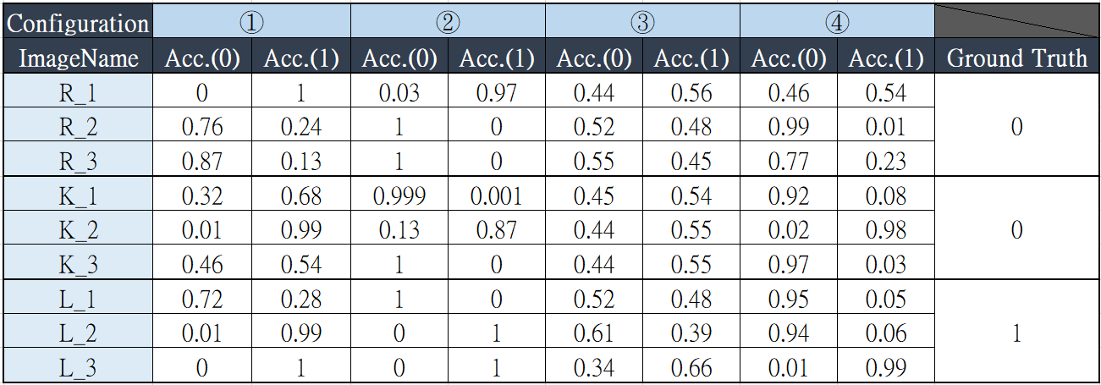
Configurations Comparison
Raw Data ⇨ Resize Resolution(256*256) ⇨ Gray Scale ⇨ Face Detection ⇨ Crop
①
②
③
④

Slide 9
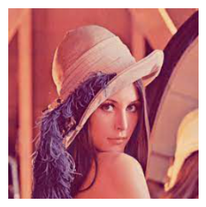
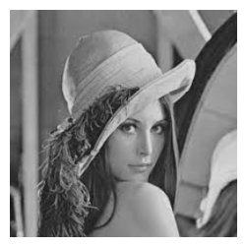
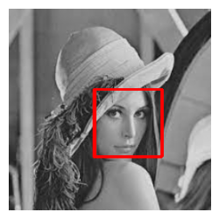
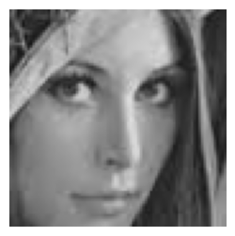
Final Processing
Raw Data ⇨ Resize Resolution(256*256) ⇨ Gray Scale ⇨ Face Detection ⇨ Crop

Slide 10

Modeling

Slide 11
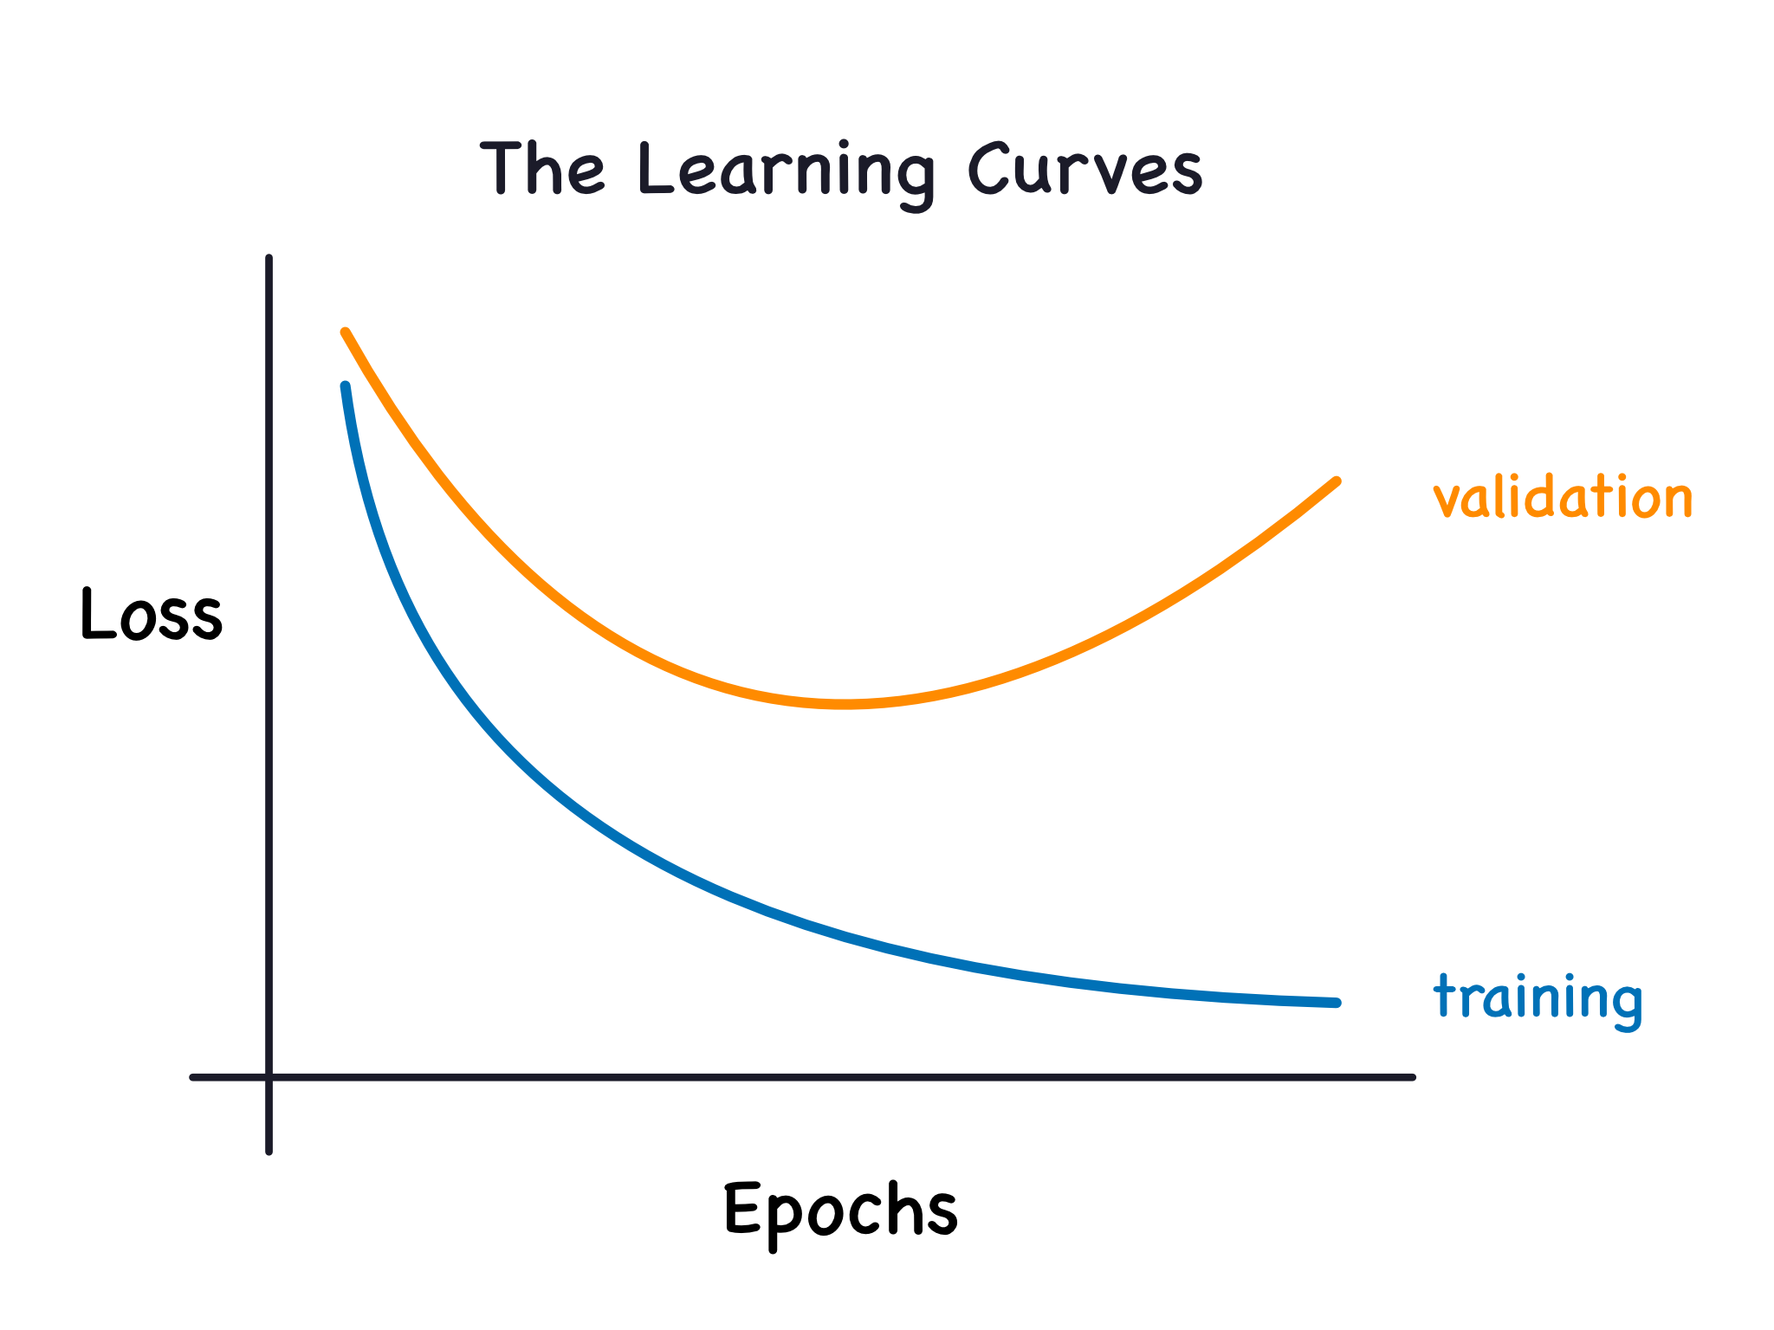
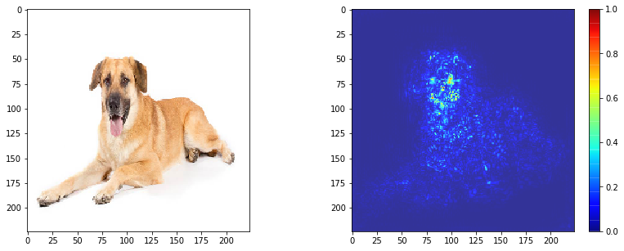

Model Evaluation
Accuracy
Learining curve
Saliency Map
https://reurl.cc/aLl2WG
https://reurl.cc/g4vKqp
https://reurl.cc/Qepzv0

Slide 12
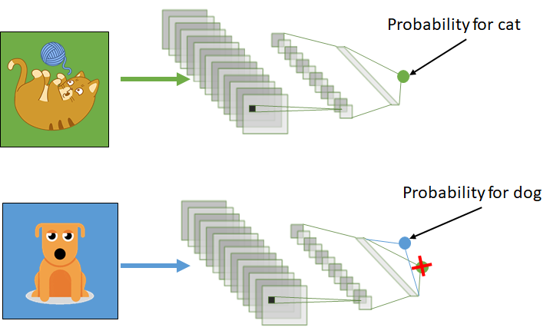

Transfer Learning
https://reurl.cc/WRdaQ7

Slide 13
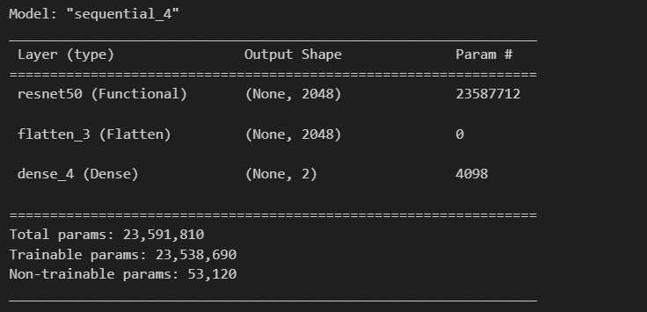
Pretrained Model：
ResNet50
Model Summary

Slide 14
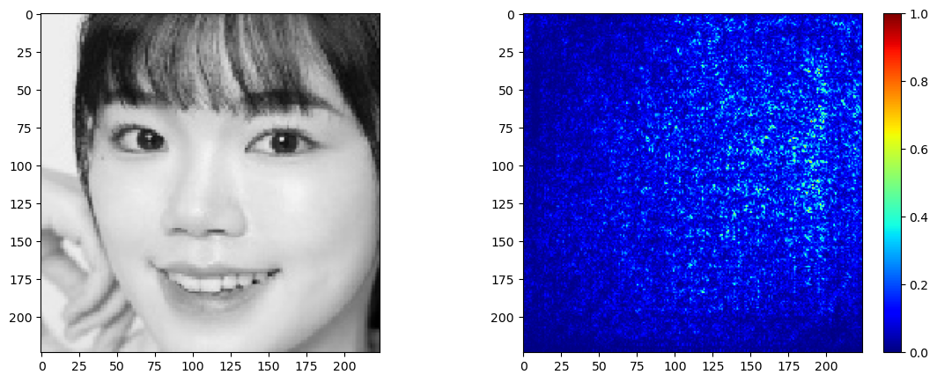
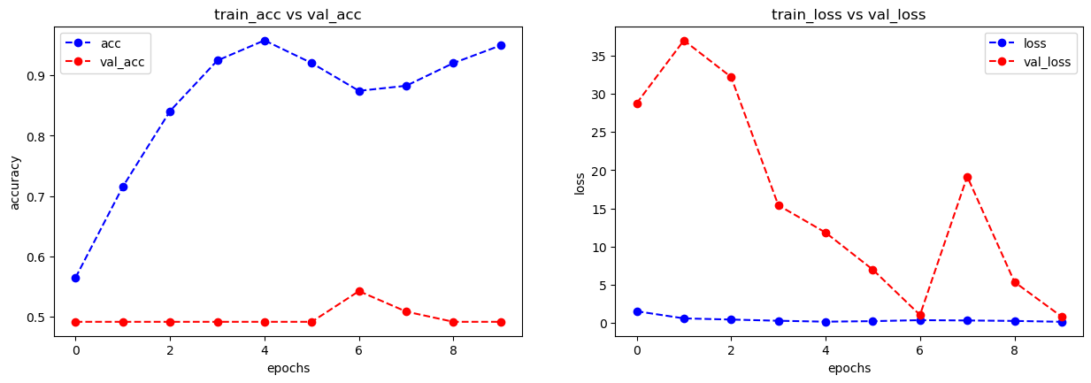
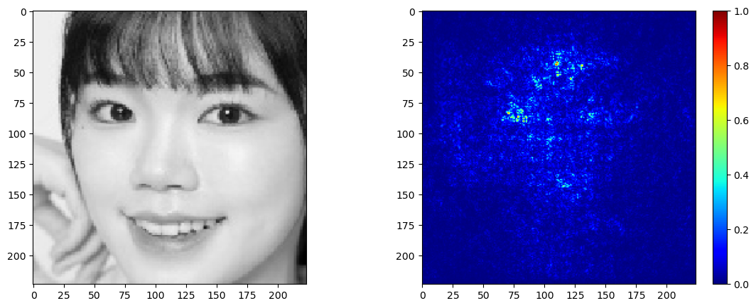
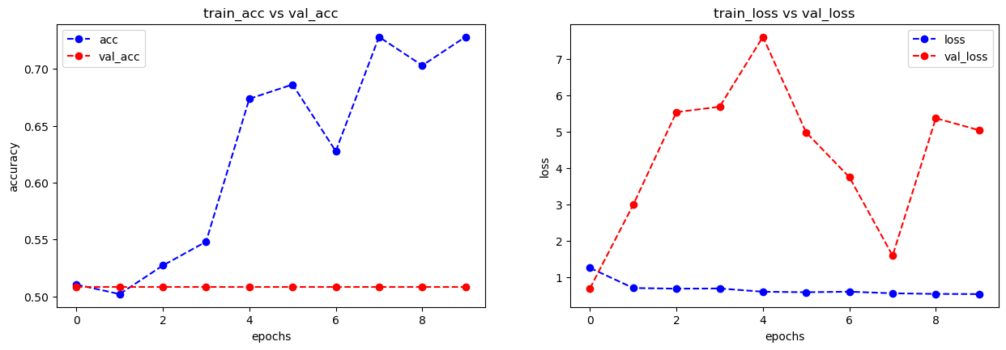
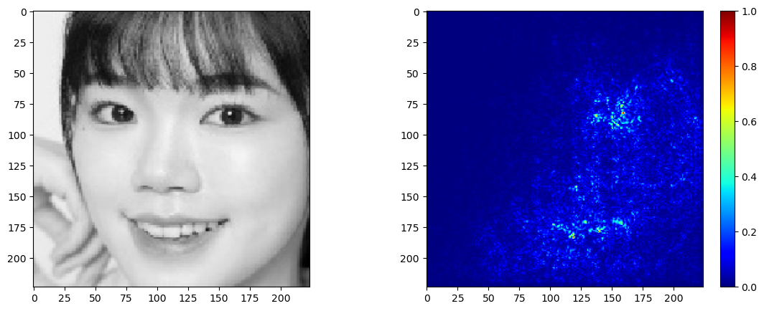
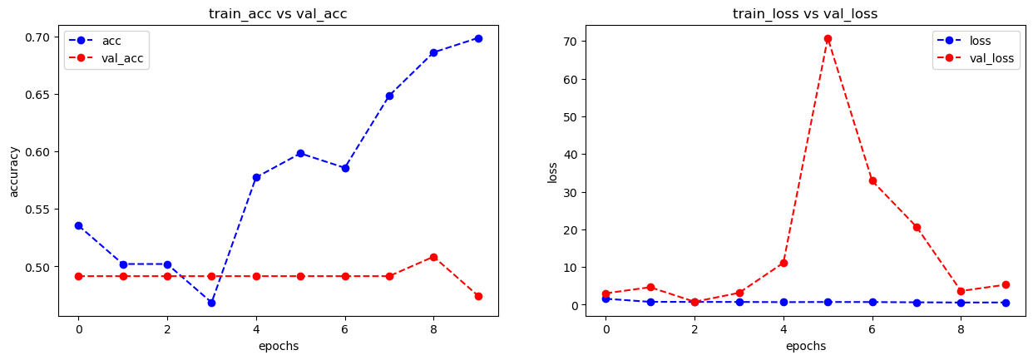
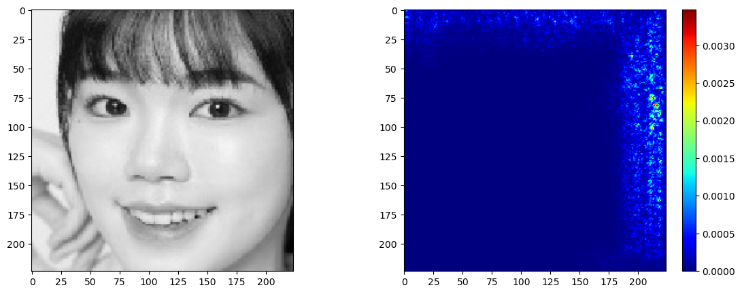
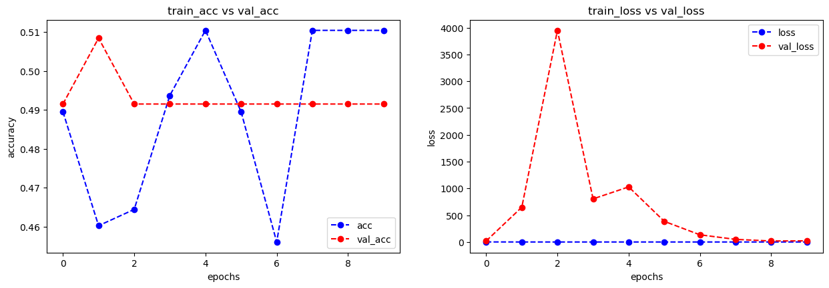

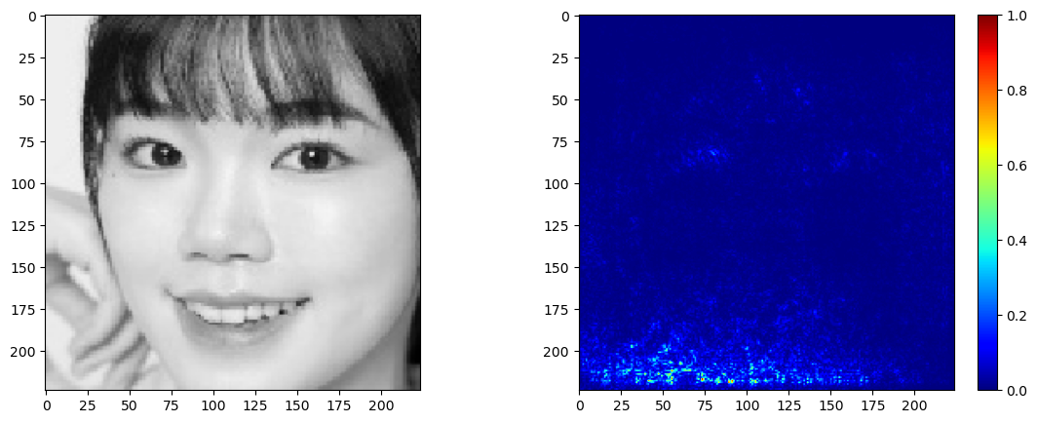
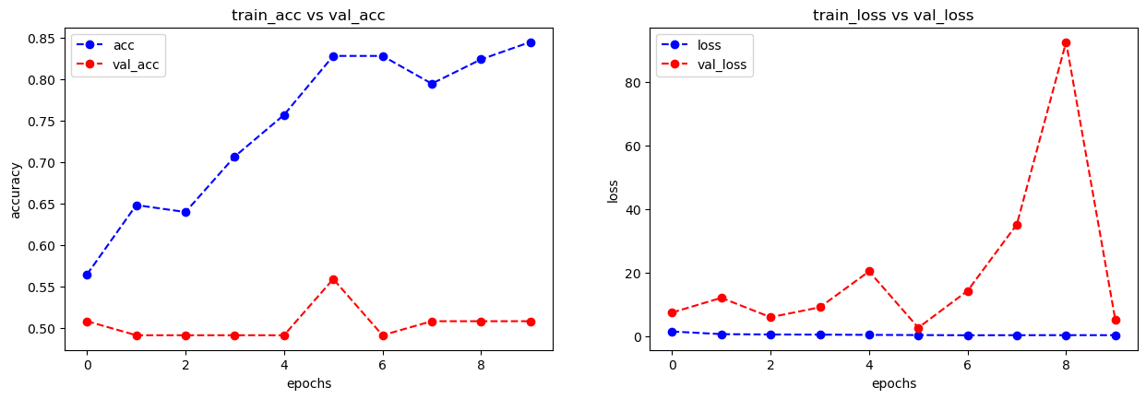
Transfer Learning Results
None
49.15%
-11
50.85%
Freeze layers
(Validation Accuarcy)
-50
47.46%
-105
49.15%
-147
50.85%

Slide 15
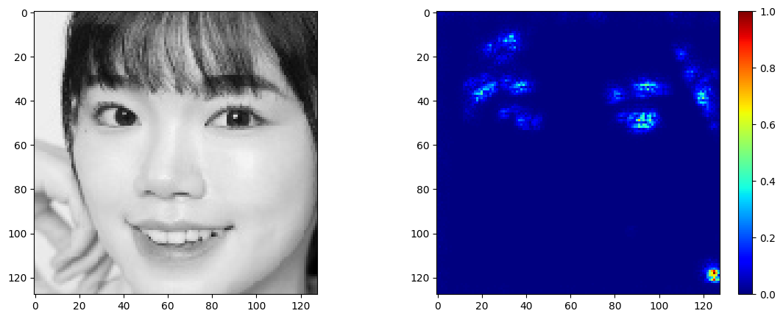
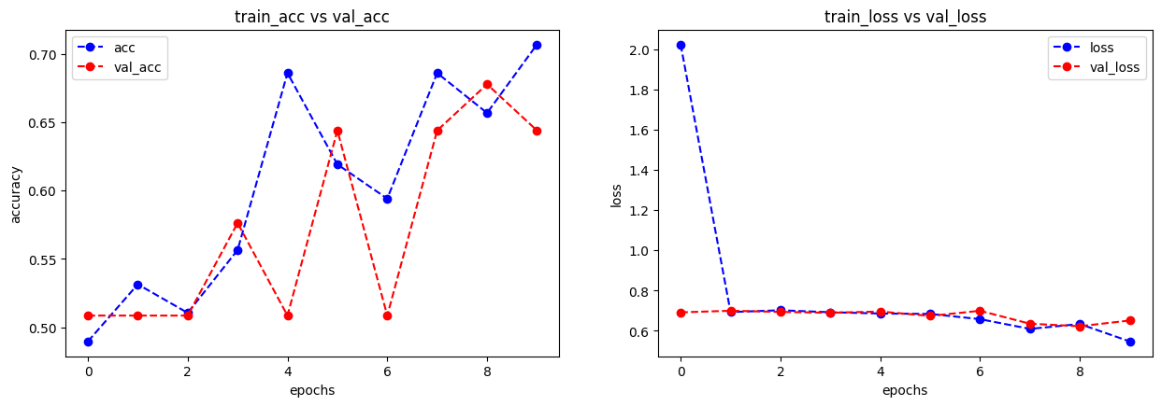
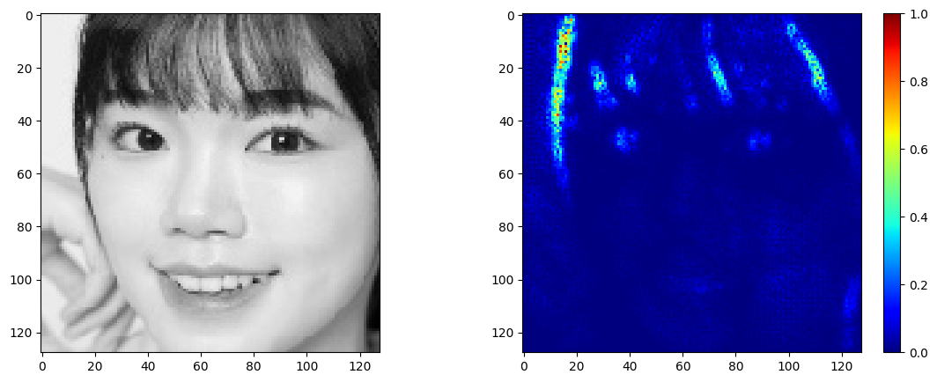
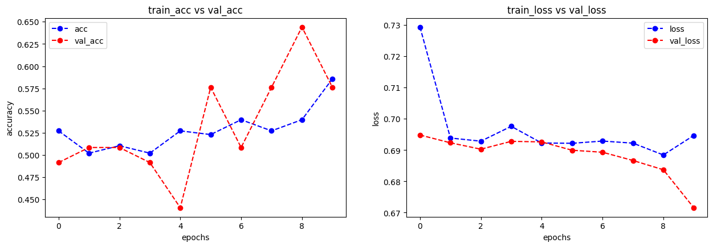
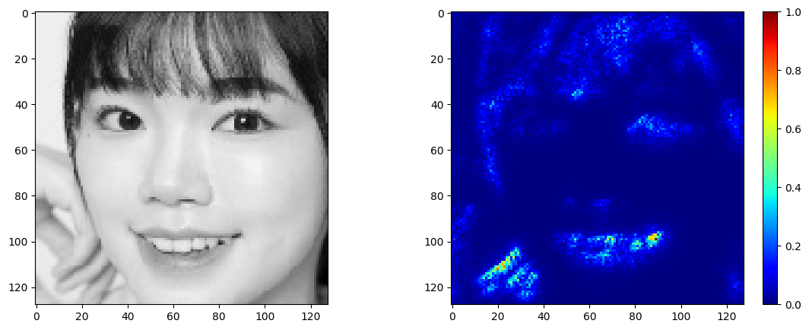
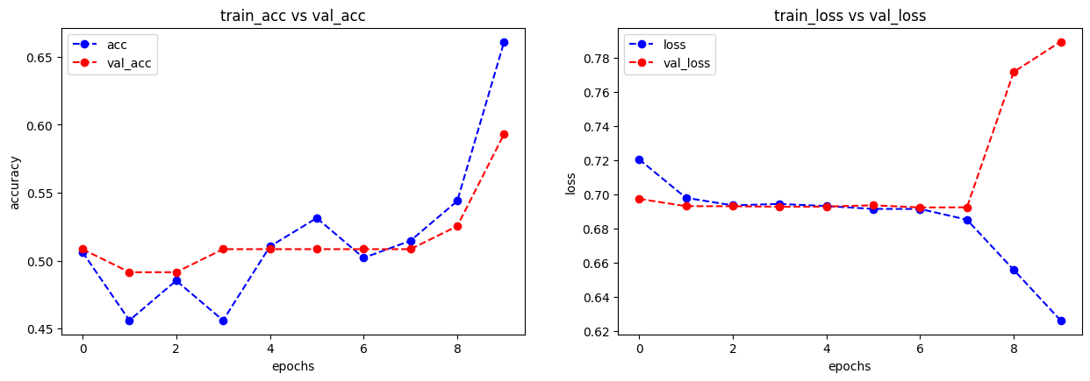
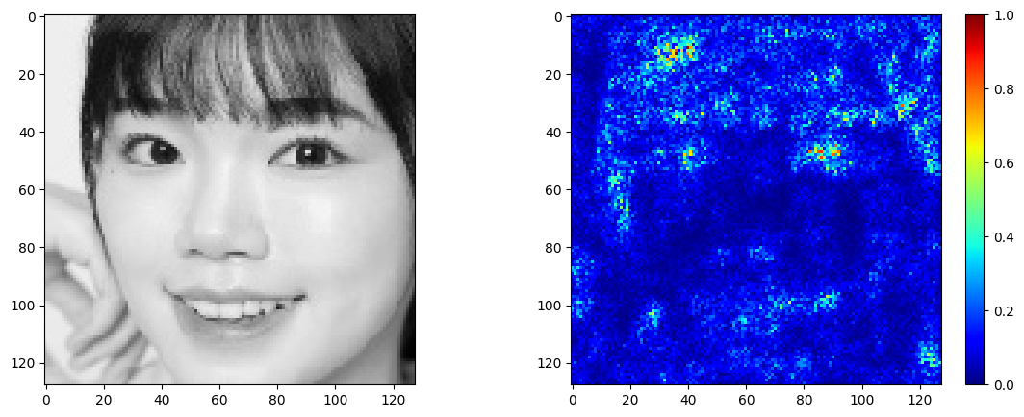
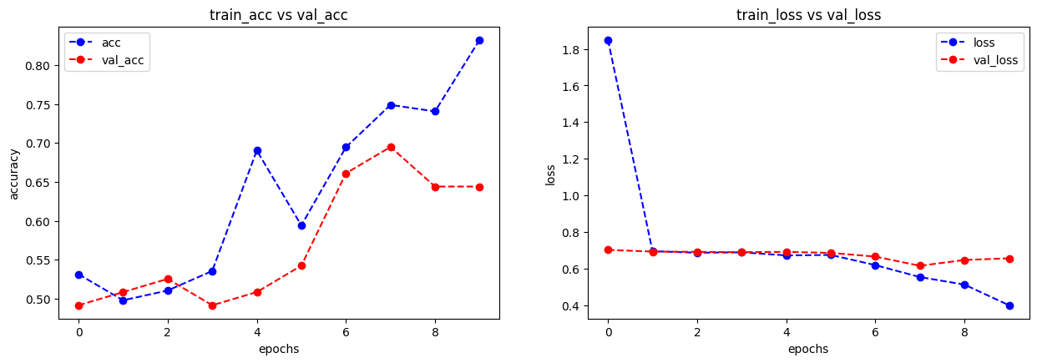
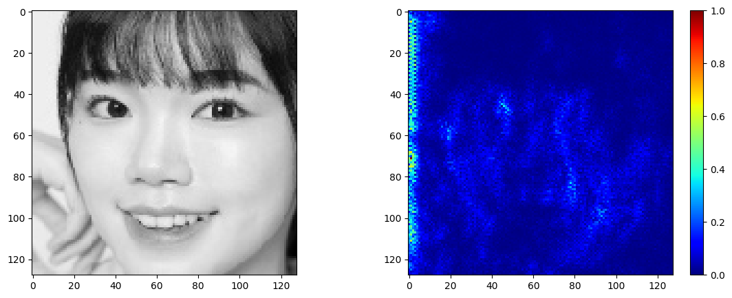
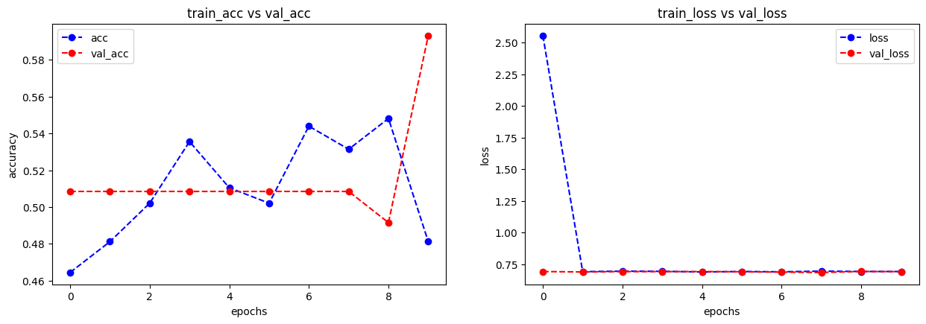
Custom CNN Model Results
67M
65.62%
44%
34M
62.25%
77%
Params
Validation
Test
8.4M
53.12%
55.6%
16M
64.41%
55%
67M
65.62%
44%

Slide 16
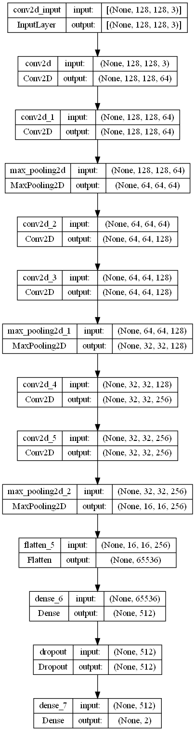
Model Architecture
ResNet50
Custom

Slide 17

Application

Slide 18
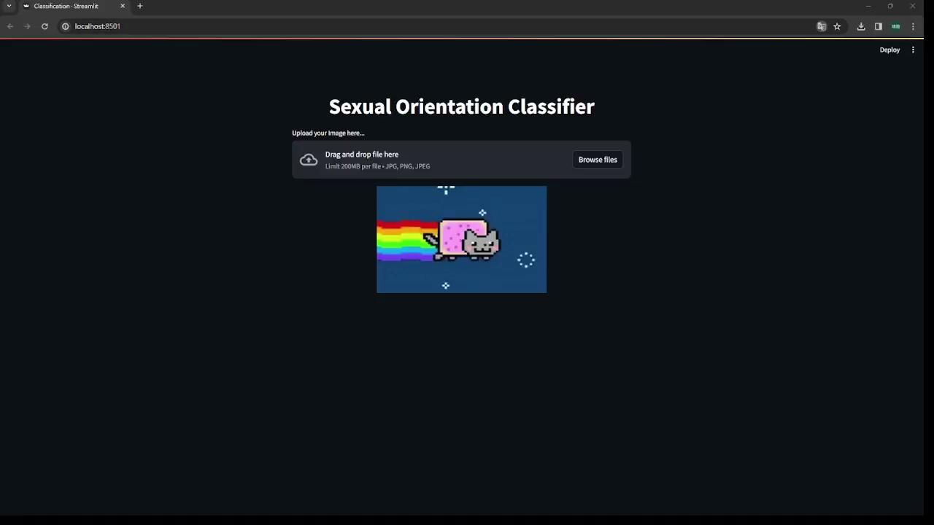
Streamlit Demo

Slide 19
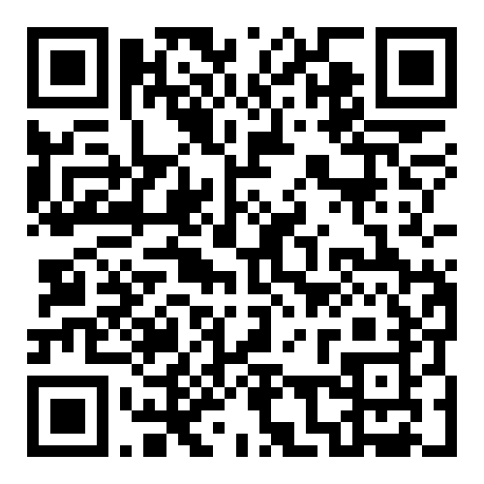

Web Application
Disclaimer：
Non-Discriminatory Exposure
Training Data Size Impact
Class-Specific Visibility
Relevance to Document Content
Web url：(Abandoned)
https://dspysexualclassification.streamlit.app/
Notes:
強調他們可以自己決定要不要上傳

Slide 20

Conclusion

Slide 21
Results
This project successfully distinguishes sexual orientation, achieving a validation accuracy of 56.3% and a testing accuracy of 77.8%, based on a dataset of 400 training images.
Dataset : 400 images
Training : 320 images
Validation : 80 images
Testing : 9 images

Slide 22

Q&A and Discussion
Thanks for your attention

